Slide 1


SAP Full-Stack Developer training
ABAP on HANA, UI5 & Fiori, Analytics with OData
Anubhav Oberoy
Day – 19

Slide 2

Agenda – Day 19
Introduction of Analytic Designer
Difference between Story & Application
Hierarchies Representation
Creating Analytic Designer Application
Understanding SAP Fiori Integration
--Break--
Describing Connection
Types of Connection
Acquired Data Connection
Live Data Connection
Showing How it Works
Create CDS for Analytics
Consume CDS View in Analytics Cloud (SAC)

Slide 3

SAP Analytics Designer
SAP Analytics Cloud, analytics designer enables analytics application designers to create centrally governable analytic content, ranging from dashboards achieved through guided analytics to sophisticated Planning and Smart applications.
SAP Analytics designer Completes the Analytics Cloud. It gives us advance scripting capabilities with which we can design complex applications like SAP Lumira designer.
We can use different controls like Input, Dropdown, Checkbox, Radio Button, and powerful scripting capabilities using Java Script lightweight.
Java Script is a browser’s programming language.
It has nothing to do with Java Programming. Every browser understand JS Directly.

Slide 4
Story v s Application
Covers Standard Scenario
01
01
Covers Custom Scenario
Non-technical consultants
02
02
Programmers/App Developers
Build Dashboards for BI , Planning etc.
03
03
Design end to end apps which can call SAP Backend systems
Like BOBJ Designer, Crystal
04
04
Complex Applications as per needs
Has features of stories + Extra

Slide 5
Hierarchy Representation
Hierarchical Representation
Flat Representation

Slide 6
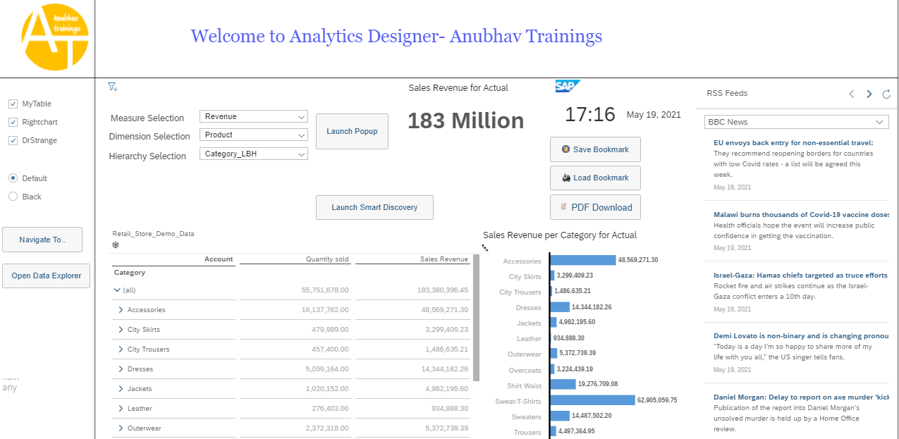
Creating Analytic Designer Application

Slide 7
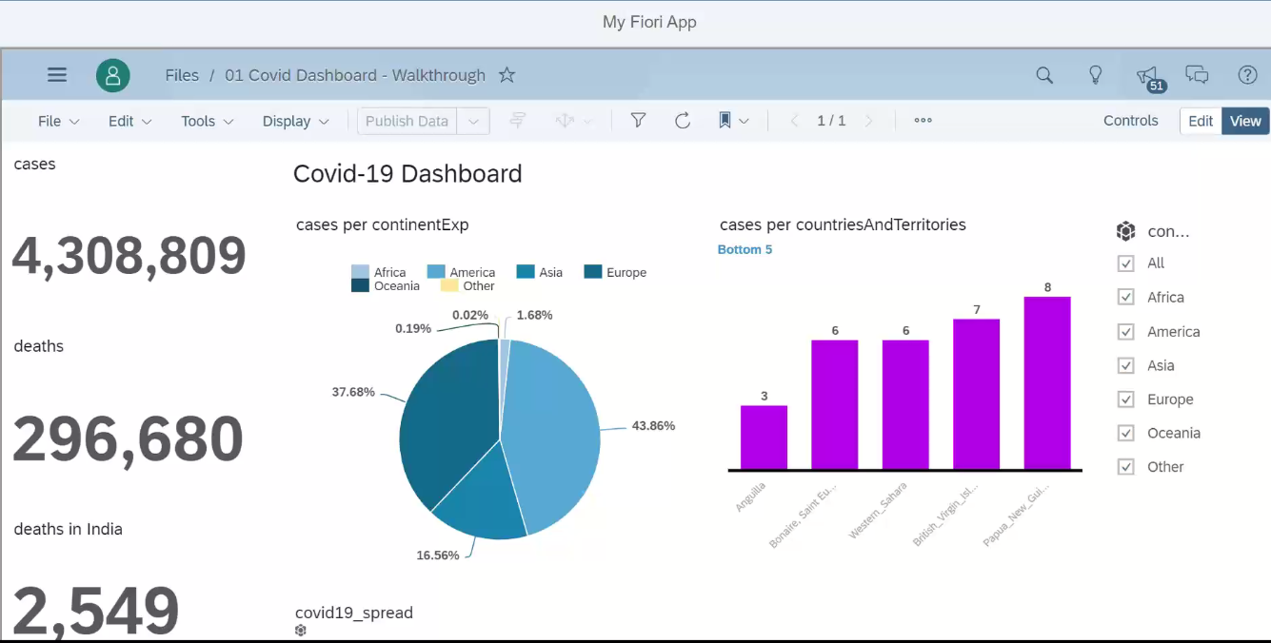
Fiori Integration

Slide 8

Break

Slide 9

Connection
Acquired Data
Connection
Connection with Real system but SAC will fetch all the data and load it in itself
All the data will be stored securely in SAC, but the data security is subjected to SAC
Data needs to be updated timely basis using update jobs
New data is available in SAC near Real-time
All the smart features are supported on Acquired data
E.g. Google drive, S/4HANA Connection, BW, BPC, DowJons, …
Live Data Connection
Data is NEVER replicated in SAC but only the skeleton/structure of the data is stored in SAC (metadata)
When the stories are executed, data will be
loaded at runtime from the target system
Data Security, roles, constraints will be the duty of source system. Data is always real-time
We can reuse existing assets like CDS, Bex, InfoProviders, Universe
Little performance lag

Slide 10

How Connection Works
Intranet
Connection
In.A
SAP Analytics Cloud
SCC
Source System On-prem
SAC Analytic Agent
Connection
Adaptor
Source System
On-prem (AWS)
ABAP
SAP HANA

Slide 11
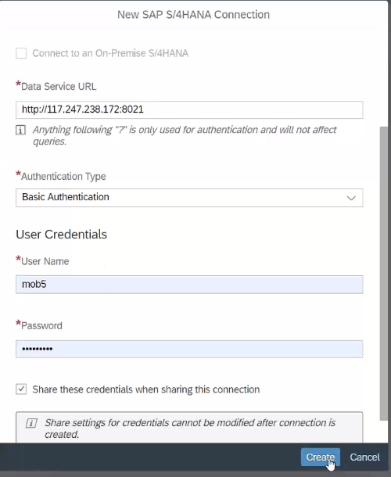
Acquired Data Connection

Slide 12

Creating CDS View for Analytics
CDS View Code

Slide 13
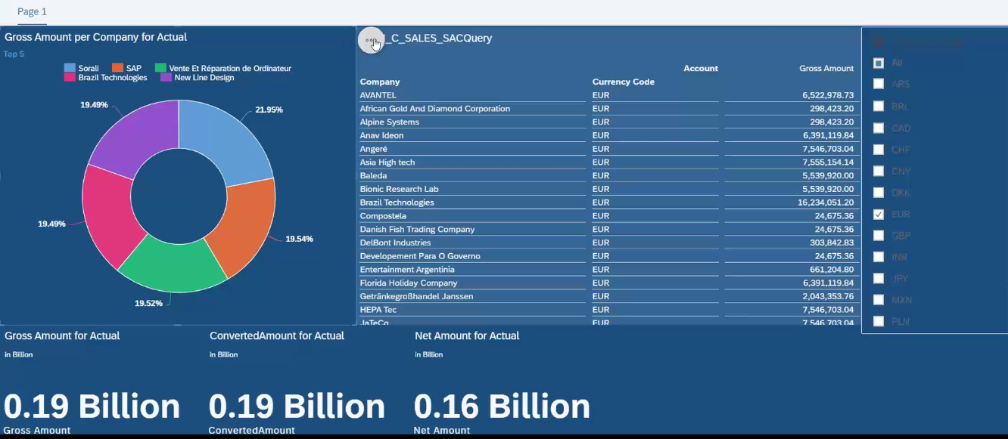
Consume CDS in Analytics Cloud

Slide 14

End of Day 19

Slide 15

Questions

Slide 16

Anubhav Oberoy

Slide 17


We’re committed to empower you to be
Most Desirable Resource
through powerful training solutions.
We build the workforce of the future.
250+
Corporate Clients
30,000+
Learners Trained
25000+
Learners Placed
FREE WEBINARS
Sign up for free webinars with industry experts every fortnight!
Enroll Now!
Contact us today!
https://anubhavtrainings.com/

Slide 18




More from AnubhavTrainings.com

